Slide 1

Prediction Of COVID-19 Cases

Slide 2
Group Members:
MirenKumar Patel(0782036)
Priyal Patel(0795099)
Yash Patel(0797825)
Navjot Kaur(0796641)

Slide 3
1. Problem Statement
2. Project Objectives
3. Dataset Information
4. Dataset
5. Data exploration and Visualizations
7. Model Prediction
7. Challenges
Covid-19 Prediction
8.References
6. Why Machine Learning ?

Slide 4
Problem Statement:
Three months ago, reports surfaced out of China that a cluster of pneumonia cases in the central city of Wuhan may be due to a new type of coronavirus.
The World Health Organization said at the time it was still assessing the extent of the outbreak, but noted there were no reports of novel coronavirus outside Wuhan.
Since then, the situation has changed drastically.
More than 1.6 million people have been infected across the globe, more than 100,000 have died and lockdowns have been ordered in numerous counties. The majority of the states in the U.S. have also adopted some sort of shelter-in-place order

Slide 5
Project Objectives:
Find the worldwide trends
Country-wise rate of increase in cases
Highest recovery rate country wise
Highest death rate country wise
Predicting trend

Slide 6
Dataset Information:
This dataset has daily-level information on the number of affected cases, deaths, and recovery from the 2019 novel coronavirus. Please note that this is a time series data and so the number of cases on any given day is the cumulative number.
So daily-level information on the affected people can give some interesting insights when it is made available to the broader data science community.
The data is available from 22 Jan 2020
Change in cases over time at the country level

Slide 7
Dataset:
Data Source :
Total Data is around 3Lakh.
Geographic field: County, Province
Numerical Fields: Confirmed, Death, Recovered Dates: Last Updated date, Observation date

Slide 8
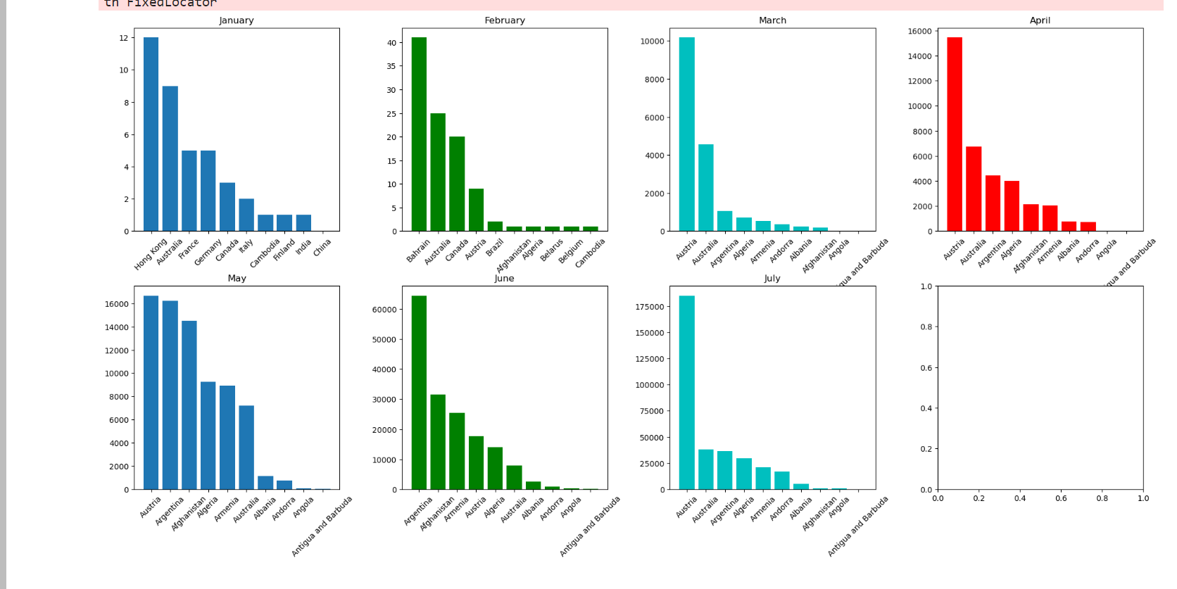
Data exploration and Visualizations:
This charts Represent monthly corona virus cases for top 10 countries. It is clearly visible that Austria had reported highest number of corona patience throughout this period among other countries.

Slide 9
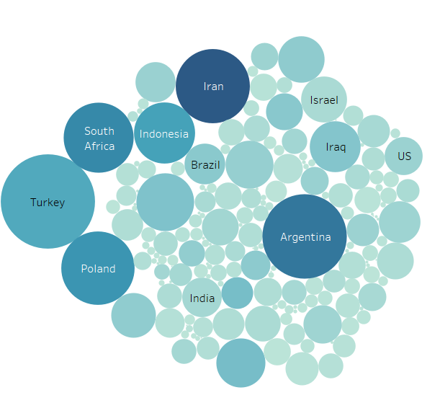
This chart represents number of Average confirmed cases as well as Death cases according to country. Iran has the highest number of cases, more than 13Lakh and deaths are nearly 16K.

Slide 10
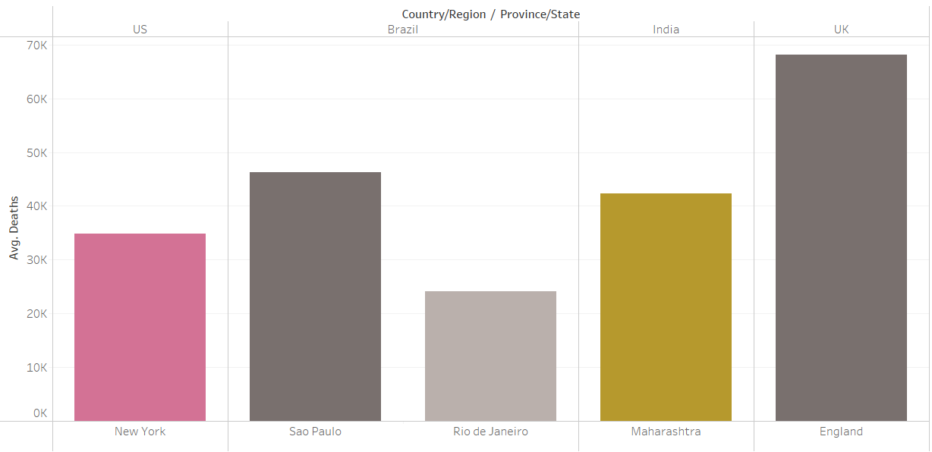
Average of Deaths for each Province broken down by Country. Color shows details about Province. The data is filtered on minimum of Last Update, which keeps no members. The view is filtered on Province, which keeps England, Maharashtra, New York, Rio de Janeiro and Sao Paulo.

Slide 11
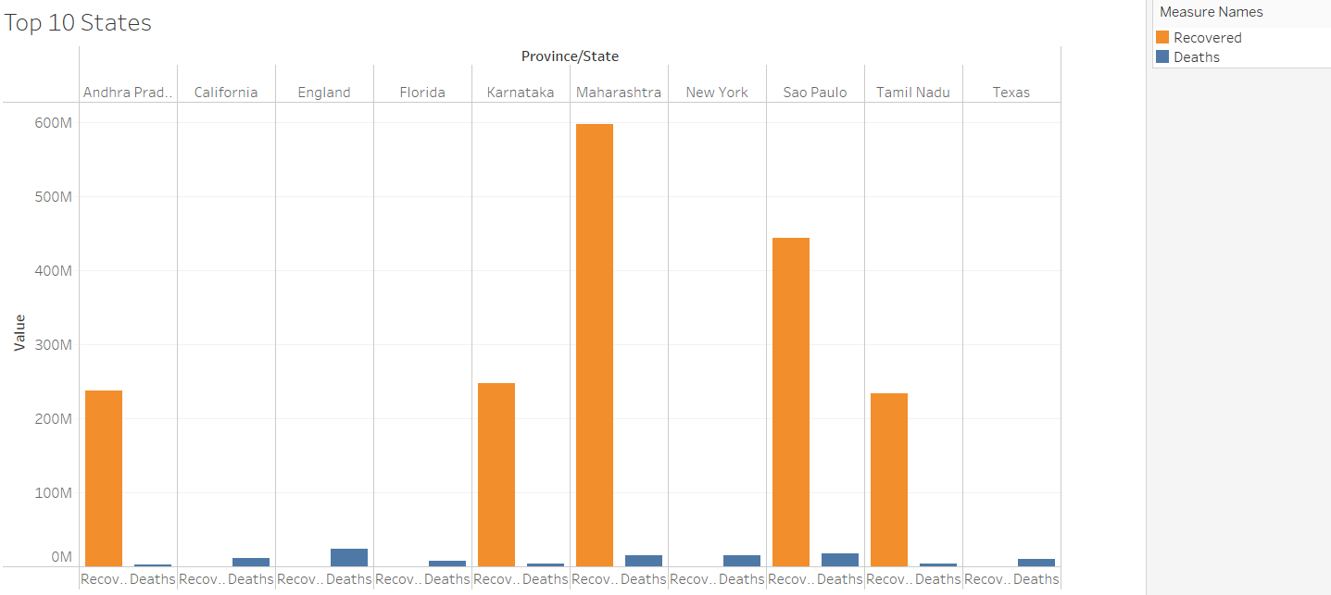
Deaths and Recovered for each Province/State. The color shows details about Deaths and Recovered. The view is filtered on Provience/State for Average Death.

Slide 12
Why Machine Learning ?
To Develop a model which will predict the confirmed case of Covid-19 based on the given data.

Slide 13
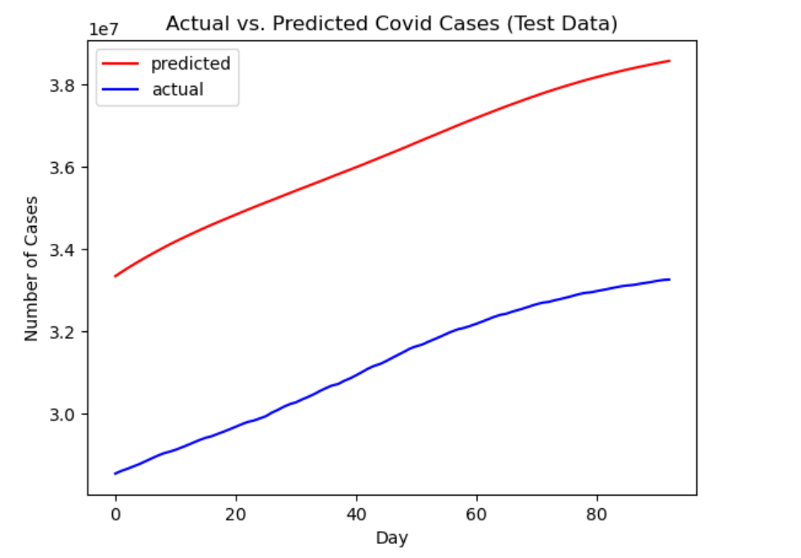
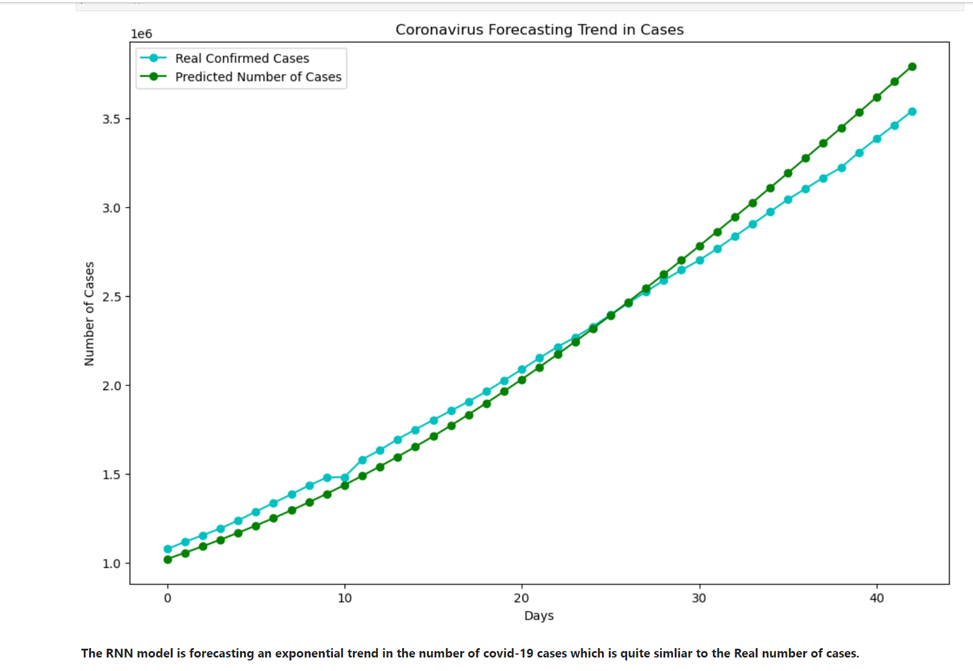
Model Prediction:

Slide 14
Challenges:
There were many challenges faced while developing models, as we were keen on predicting the case and don’t just want to check the accuracy of a model.
So for this we had to learn a new way of training the data which is called LSTM(long short-term Memory) and for doing this we have to look around so many websites to finally achieve the desired output.
We did face some challenges while working on the tableau for the graphical representation of the data but at the end with the help of some friends and internet those were solved.

Slide 15

Questions….

Slide 16
References
Some References
https://towardsdatascience.com/lstm-recurrent-neural-networks-how-to-teach-a-network-to-remember-the-past-55e54c2ff22e
https://machinelearningmastery.com/gentle-introduction-long-short-term-memory-networks-experts/
https://intellipaat.com/blog/what-is-lstm/

